Slide 1


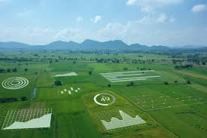
CROP YIELD PREDICTION WITH MACHINE LEARNING REGRESSION MODELS
TEAM MEMBERS:
DHARSHINI M S [927622BAL008]
JAYARAJ V [927622BAL017]
MOULI M E [927622BAL027]
RAGHAVARDHINI T [927622BAL037]

Slide 2
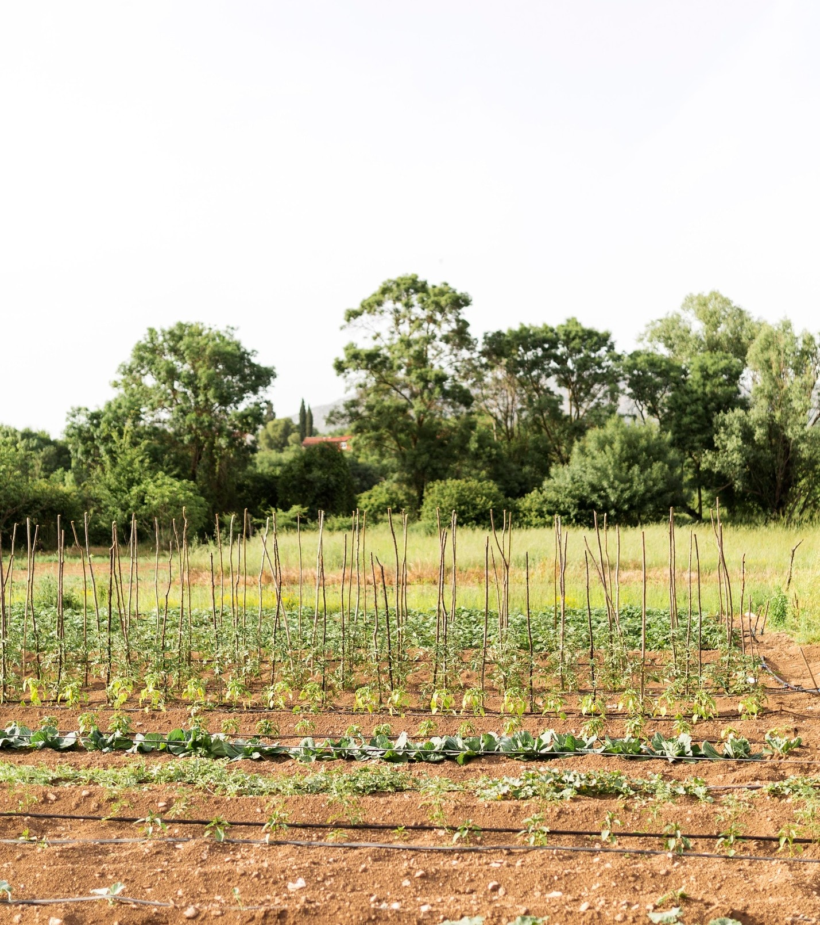
PROBLEM STATEMENT
Farmers are facing some difficulties in choosing their crop to cultivate , if the farmers chooses one crop instead of another crop, It leads to minimize in farming and maximize in Loss.
So to, Overcome this problem, proposed machine learning technique for yield prediction process.

Slide 3

INTRODUCTION
Predicting crop yields is crucial for farmers to plan ahead. Machine learning analyzes past crop yields and weather data to make educated guesses about future growth.
This helps farmers make smart decisions on planting and caring for crops, ultimately increasing food production and resilience to challenges.

Slide 4

ABSTRACTION
Agriculture plays a major role in economic growth and development.
This proposed system can change the situation of farmers and decisions making in agricultural field in a better way.
The parameter includes in the dataset are State Name, Crop Name, Size of the Area(Sqft), Season and Rainfall(mm).

Slide 5

PROPOSED SOLUTION
Our solution involves developing a regression model using data parameters such as state, crop type, land size, season, and rainfall.
By analyzing these factors, the model will predict crop yields accurately.

Slide 6

PROPOSED SOLUTION
This tool will empower farmers with valuable insights, enabling them to plan their agricultural activities more effectively and optimize their resources.
Through this solution, we aim to improve agricultural decision-making and ultimately enhance the livelihoods of farmers.

Slide 7

DATASET DETAILS
We have collected the dataset for the crop prediction from real world sensor data available in Kaggle.com . This dataset contain attributes such as Rainfall, Soil moisture, Fertilizer, Season, Yield.

Slide 8
Dependent Variable (Y): Crop Yield
This is the variable you're trying to predict. It represents the amount of crops harvested, typically measured in terms of quantity (e.g., kilograms/hectare, bushels/acre).
2.Independent Variables (X):
State Name: The geographical location where crops are cultivated.
Crop Name: The specific type of crop being grown.
Size of the Area (Sqft): The area of land dedicated to crop cultivation.
Season: The specific season during which crops are grown (e.g., spring, summer, fall).
Rainfall (mm ):The amount of precipitation received during the growing season.

Slide 9

PRE-PROCESSING
Clean Data: Remove errors and missing values from our dataset.
Feature Selection: Identify and select relevant features (parameters) such as state, crop type, land size, season, and rainfall.
Data Transformation: Scale or transform the data to ensure uniformity and meet regression model assumptions.

Slide 10
PRE-PROCESSING
Handle Categorical Variables: Convert categorical variables like state and crop type into numerical representations.
Split Dataset: Divide the dataset into training and testing sets for model evaluation.

Slide 11

MODEL EVALUATION
Thorough evaluation of regression models using metrics like RMSE (Root Mean Square Error) and R-squared is critical to assess their predictive performance. This step ensures the reliability and validity of the models.

Slide 12
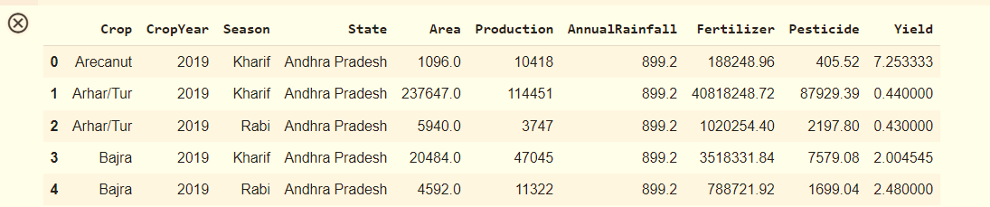
IMPLEMENTATION
import pandas as pd
data = pd.read_csv("/content/crop_yield.csv")
data.head()
import

Slide 13
x=data['Production'].values.reshape(-1,1)
y=data['Yield'].values.reshape(-1,1)
SEED = 40
from sklearn.model_selection import train_test_split
x_train, x_test, y_train, y_test = train_test_split(x, y, test_size = 0.2, random_state = 30)
from sklearn.linear_model import LinearRegression
regressor = LinearRegression()
regressor.fit(x_train, y_train)
y_pred = regressor.predict(x_test)

Slide 14
import numpy as np
from sklearn.metrics import mean_absolute_error, mean_squared_error
mae = mean_absolute_error(y_test, y_pred)
mse = mean_squared_error(y_test, y_pred)
rmse = np.sqrt(mse)
print(f'Mean absolute error: {mae:.2f}')
print(f'Mean squared error: {mse:.2f}')
print(f'Root mean squared error: {rmse:.2f}')
Mean absolute error: 108.62QQQQ
Mean squared error: 925628.81 Q
Root mean squared error: 962.10

Slide 15
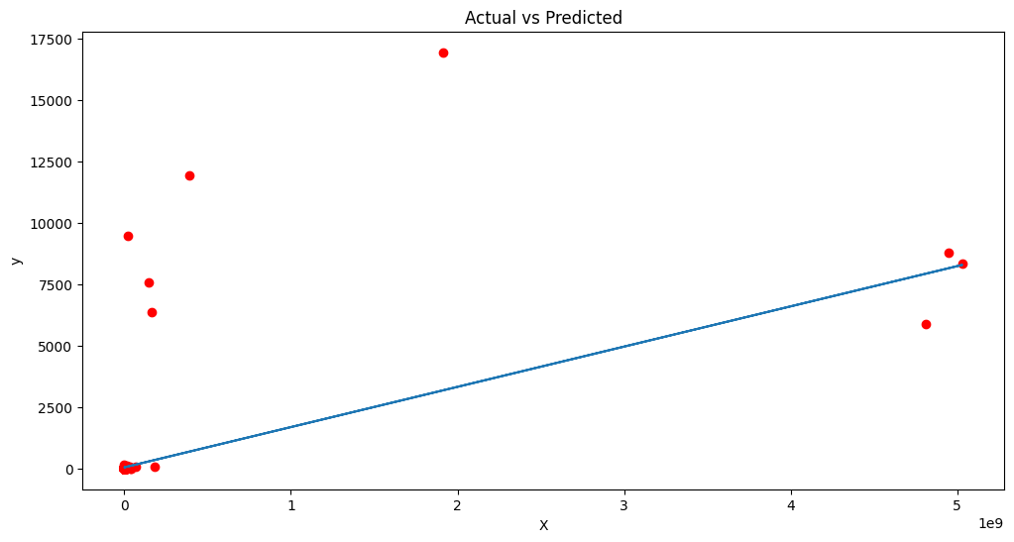
import matplotlib.pyplot as plt
plt.figure(figsize=(12, 6))
plt.plot(x,y,'ro')
plt.plot(x_test,y_pred)
plt.title('Actual vs Predicted')
plt.xlabel('X')
plt.ylabel('y')
plt.show()

Slide 16

CONCLUSION
In conclusion, leveraging machine learning regression models to enhance crop yield prediction holds immense potential for revolutionizing agriculture.
By addressing the challenges and focusing on continuous improvement, we can pave the way for a more sustainable and productive future in farming.

Slide 17
Thanks!
Do you have any questions?

